Slide 1
Economics is an Ecosystem
Jessica Kristine Navedo | lunafly | Winged Elan

Slide 2
Economy:
An economy is an area of the production, distribution and trade, as well as consumption of goods and services by different agents.
Source: Wikipedia

Slide 3
CAPITALISM
The Story That Shapes
Our World

Slide 4
“Throughout most of history, living standards were similar around the world and changed little from century to century.
Since 1700 they have risen rapidly in some countries.
This upturn coincided with rapid technological progress, and with the advent of a new economic system, capitalism, in which private property, markets and firms play a major role.
The capitalist economy provided incentives and opportunities for technological innovation, and gains from specialization.”
Source: https://core-econ.org/the-economy/book/text/01.html#112-conclusion

Slide 5
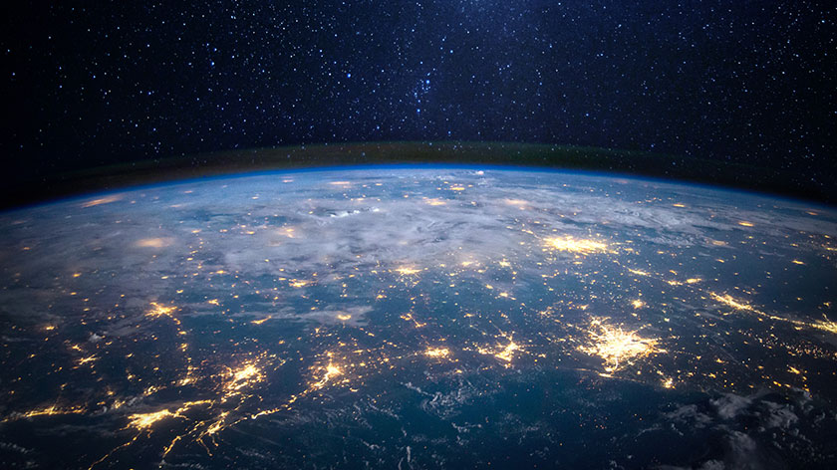
ENERGY!

Slide 6
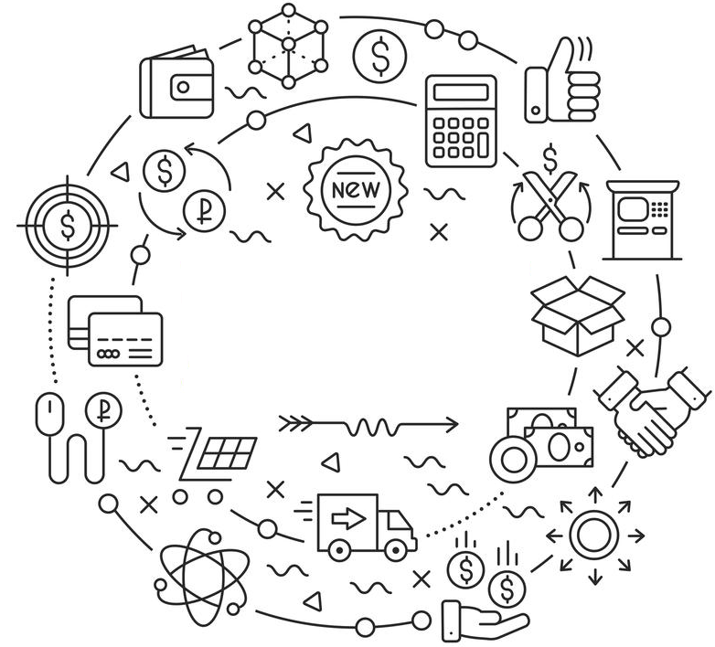
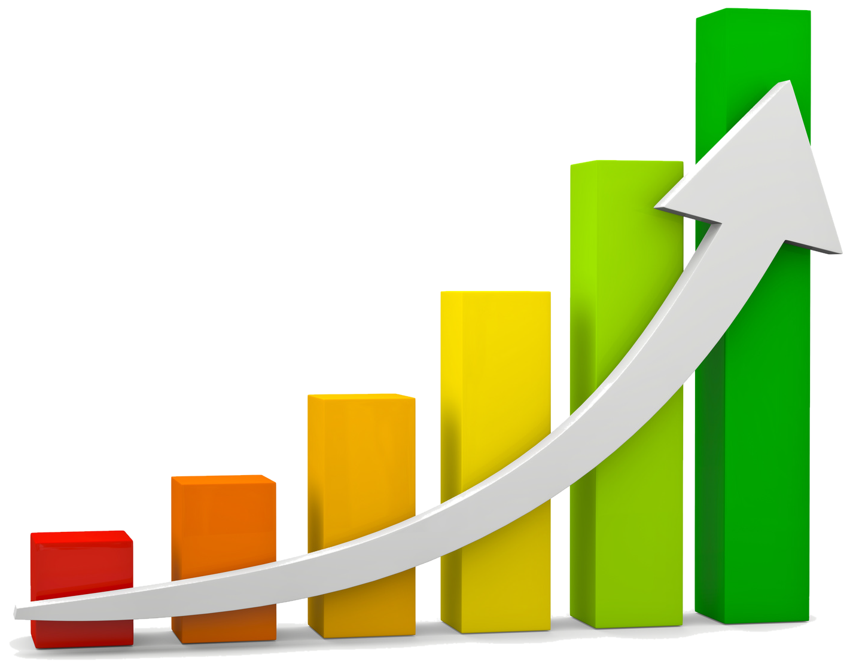
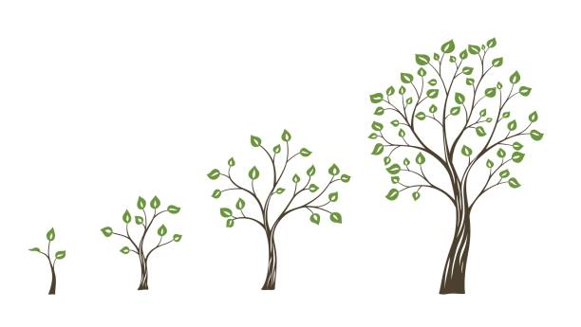
INSTITUTIONS
MARKET
GROWTH

Slide 8
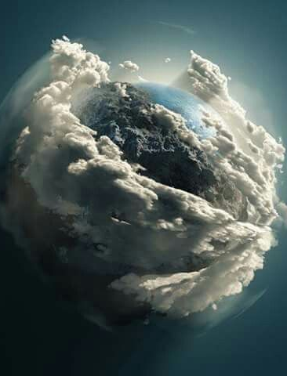
Finite Earth

Slide 9
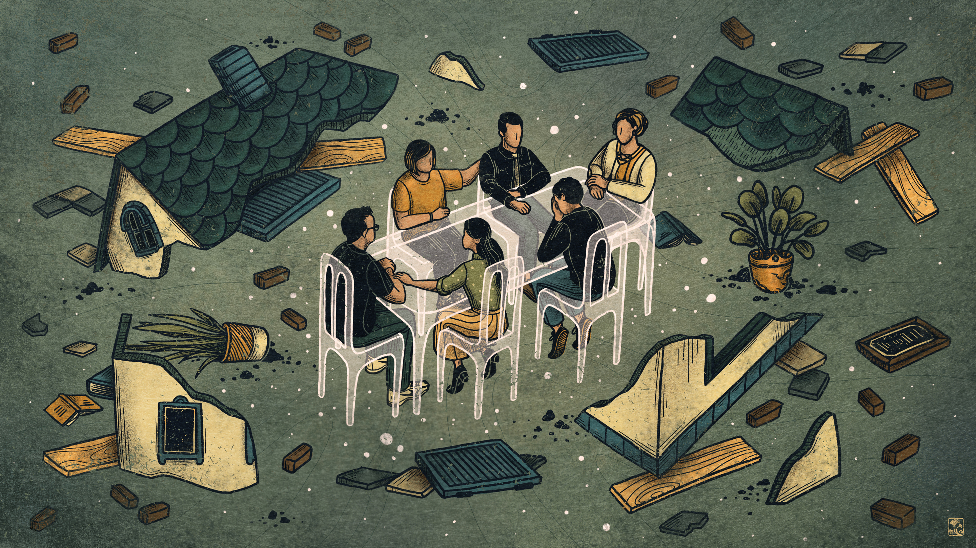

Slide 10
From Linear to circular

Slide 11
How we describe our actions in the world affects the kinds of actions we take in the world. ~Daniel H. Kim

Slide 12
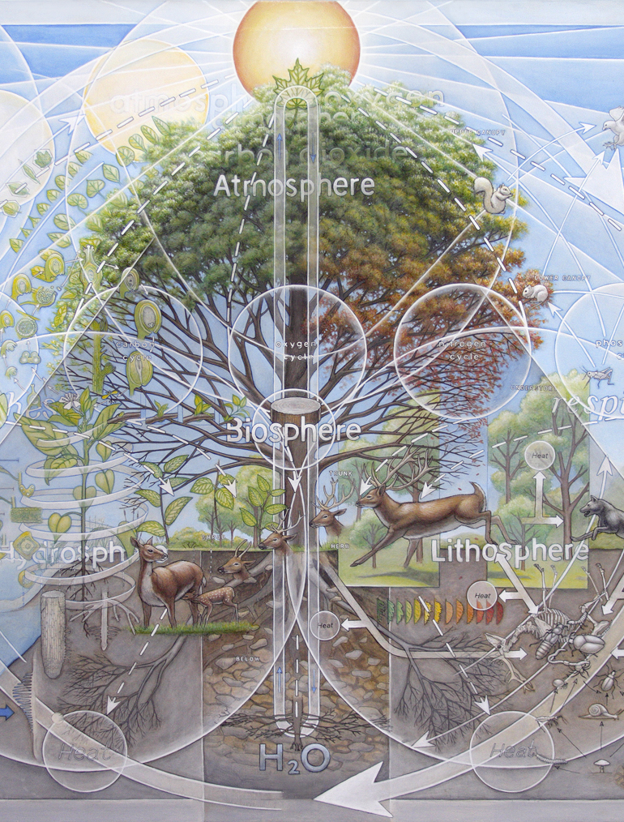
Ecosystem:
An ecosystem is a community of living organisms in conjunction with the nonliving components of their environment, interacting as a system.
Source: Wikipedia

Slide 13
Economy:
An economy is an area of the production, distribution and trade, as well as consumption of goods and services by different agents.
Source: Wikipedia

Slide 14
Doughnut Economics
: 7 Ways to Think Like a 21st Century Economist
By Kate Raworth

Slide 15
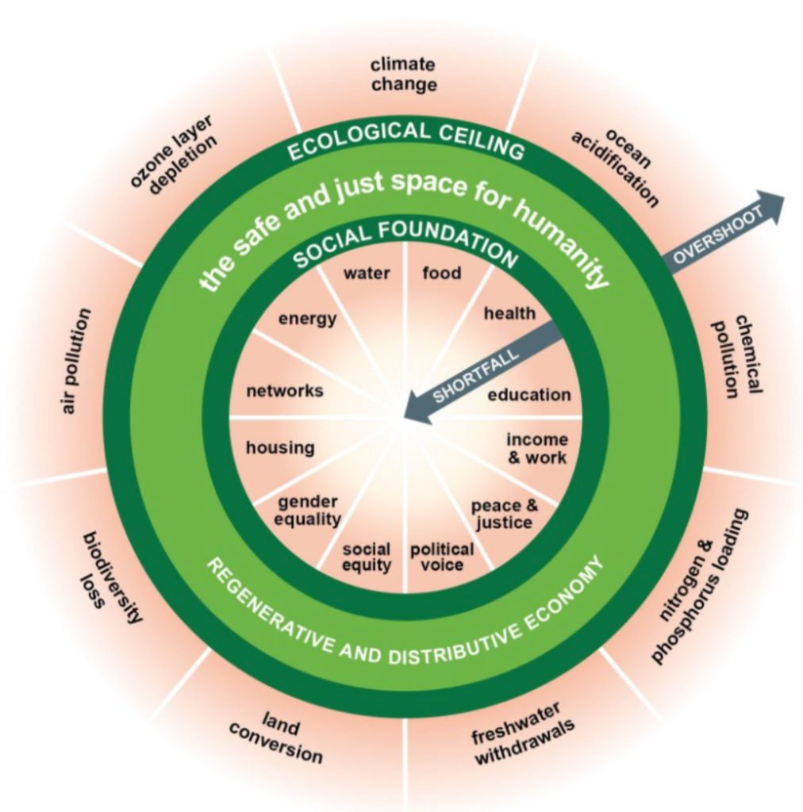
1. CHANGE THE GOAL : The Doughnut

Slide 16
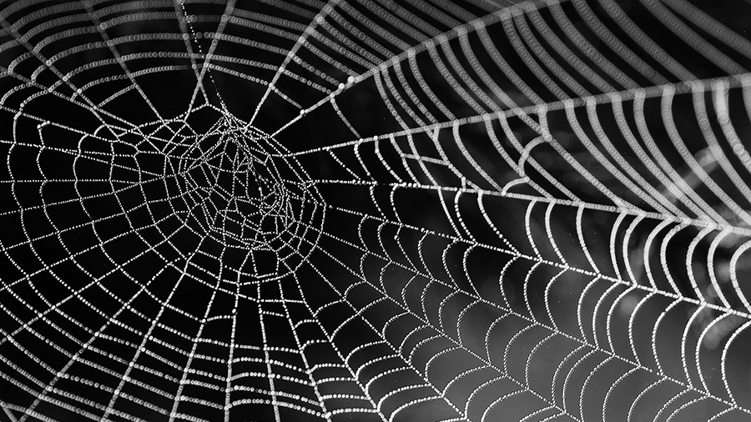
GOAL: HUMAN PROSPERITY IN A FLOURISHING WEB OF LIFE
Population
Distribution
Aspiration
Technology
Governance

Slide 17
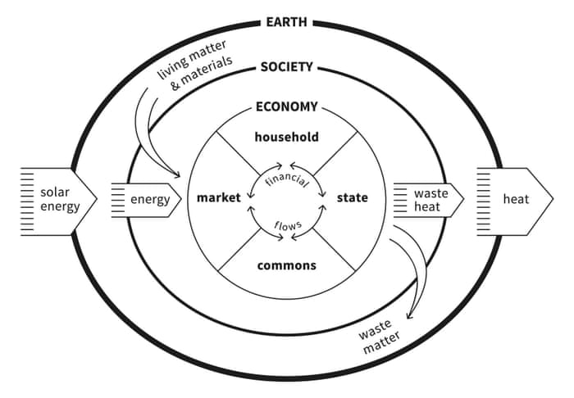
2. SEE THE BIG PICTURE : Embedded Economy

Slide 18
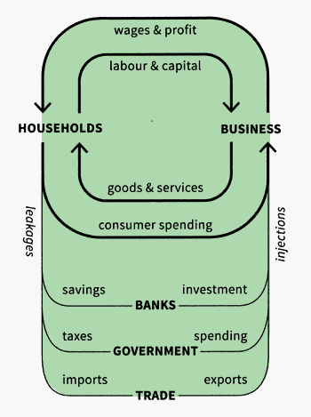
Circular Flow Diagram

Slide 19
Big Picture Activism

Slide 20
Where are You working and how?
Level of Perspective
Action Mode
Vison
Mental Models
Reflective
Systemic Structures
Creative
Patterns
Events
Adaptive
Reactive
Generative
We immediately react day-to-day events.
We can adapt patterns of events once they are recognized.
We create the structures of systems which determine patterns and events.
Our beliefs create a blueprint for how we understand the world. Investigating these gives us the ability to change them.
Vision guides the development of all lower levels. It is our “north star”.
Leverage Increases

Slide 21
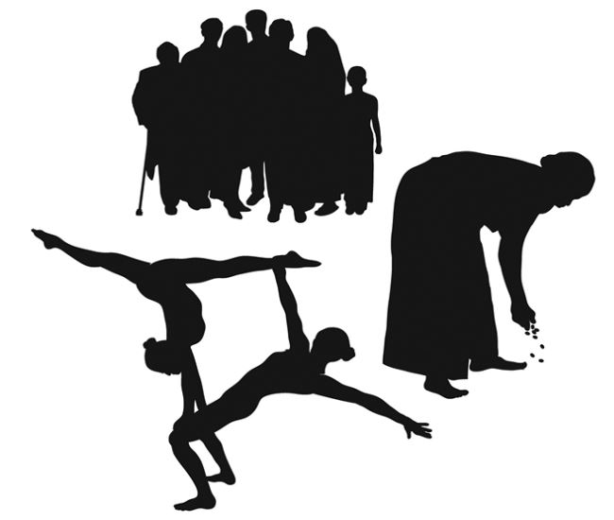
3. NURTURE HUMAN NATURE : Social Adaptable Humans

Slide 22
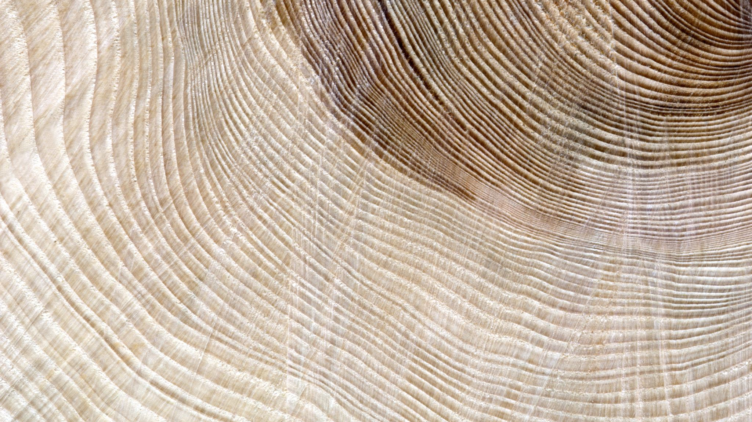
Cultural Ecology
Cultural Ecology : an ethnological approach that sees the modes of production of societies around the world as adaptations to their local environments.
Source: Sacred Ecology
“Just as the biosphere requires diversity for its strength, so it is among human cultures, where diversity and acceptance of difference are the true bases of peaceful and harmonious relationships.”
~Helena Norberg-Hodge

Slide 23
4. GET SAVVY WITH SYSTEMS : Dynamic Complexity

Slide 24
Don’t be rigid.
“…we become blinded by the beauty of the conceptual model … and lose our bearings, mistaking it for reality itself. We end up seducing ourselves.”
Source: Chapin (1988) quoted in Sacred Ecology

Slide 25
Identify the leverage points. Use what’s already available.
“Don’t be an unthinking intervenor and destroy the system’s own self-maintenance capacities … Before you charge in to make things better, pay attention to what was already there.” ~Donella Meadows

Slide 26
Knowledge-Practice-Belief
Knowledge of species and other environmental phenomenon
Practice in the way people carry out their agriculture, hunting and fishing, and other livelihood activities
Belief in peoples’ perceptions of their role within ecosystems and how they interact with natural process
…tradition cannot be divorced from the social and spiritual. Stories and legends are part of culture and indigenous knowledge because they signify meaning. Such meaning and values are rooted in the land and closely related to a “sense of place”.
Source: Sacred Ecology

Slide 27
Ethical Economic Principles from DeMartino:
Act in service to human prosperity in a flourishing web of interdependent life.
Respect autonomy in the communities you serve by ensuring their engagement and consent – with awareness of existing inequalities.
Be prudential in policymaking. Reduce harm when unsure.
Work with humility, be transparent and open to alternatives.

Slide 28
5. DESIGN TO DISTRIBUTE : Distributive by Design

Slide 29
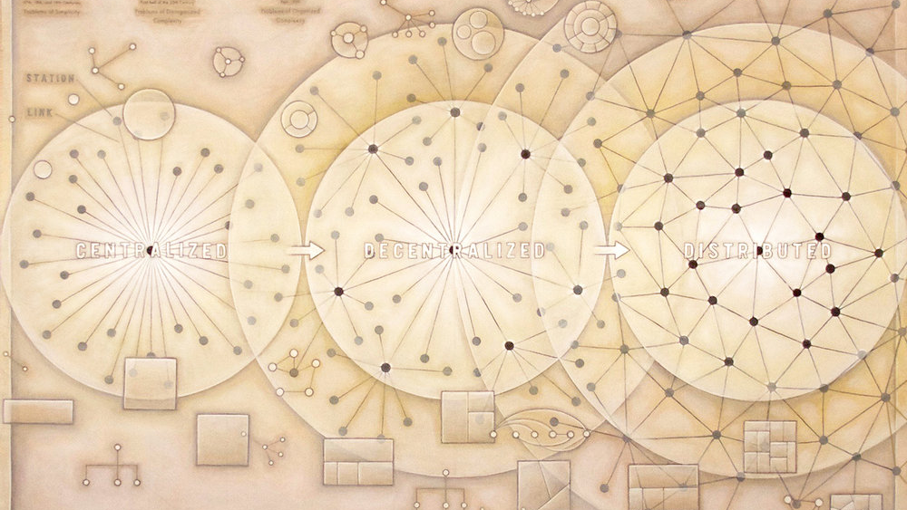
Redistribution
Who owns the land?
Who makes your money?
Who will own the robots?
Who owns the ideas?

Slide 30
People Power

Slide 31
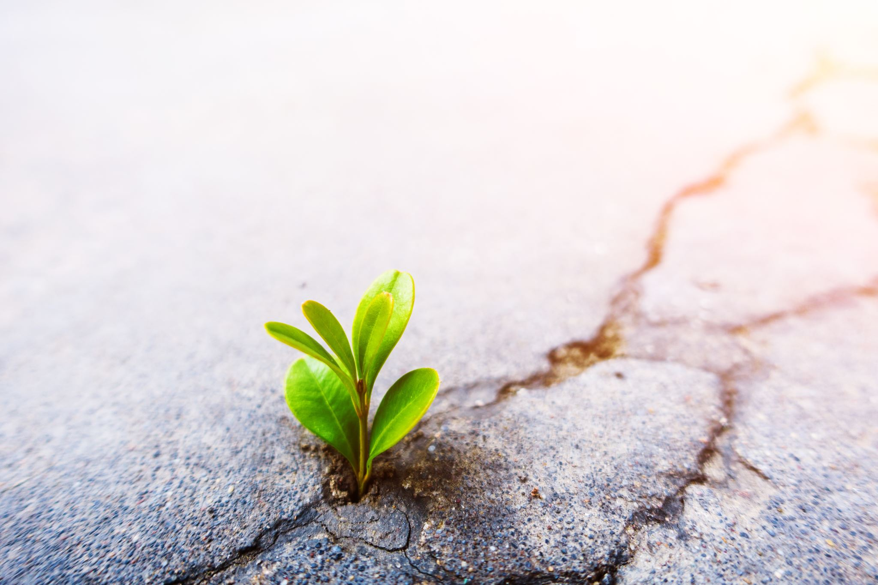
Emergent Strategy

Slide 32
Complex Movements Emblem System
Mycelium : underground network. interconnectedness. remediation. detoxification.
Ants : individual action in collective accord. cooperative work. collective sustainability.
Ferns : fractal. small-scale solutions impact the whole system. use similar principles to build at scale.

Slide 33
Complex Movements Emblem System
Wavicle : wave-particle duality. uncertainty/doubt. valuing both process and outcome.
Starlings : synchronized movement pattern, or murmuration. collective leadership/partnership. adaptability.
Dandelion : sudden seedhead, deep root. resilience. resistance. regeneration. decentralization.

Slide 34
6. CREATE TO REGENERATE : Regenerative by Design

Slide 35
The Generous City
Culturally situated
Open source and trophic
Redefining the goals of business
Finance in service to life
Partner-state
Living metrics
Regenerative industrial design can only be fully realized if it is underpinned by regenerative economic design.

Slide 36
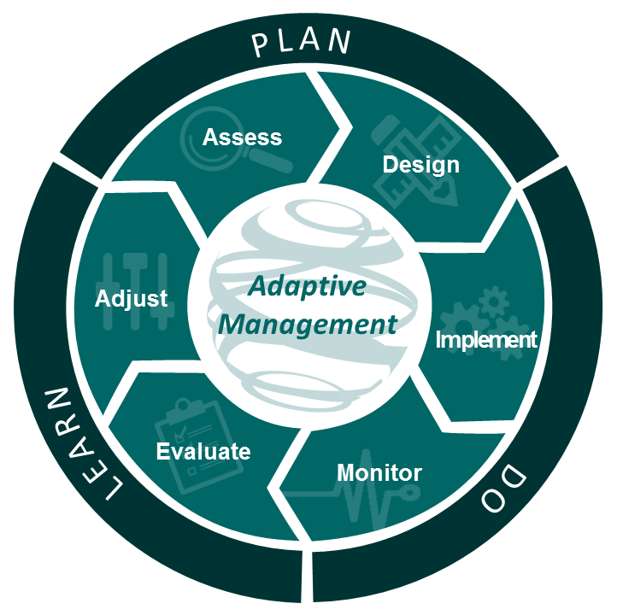

Slide 37
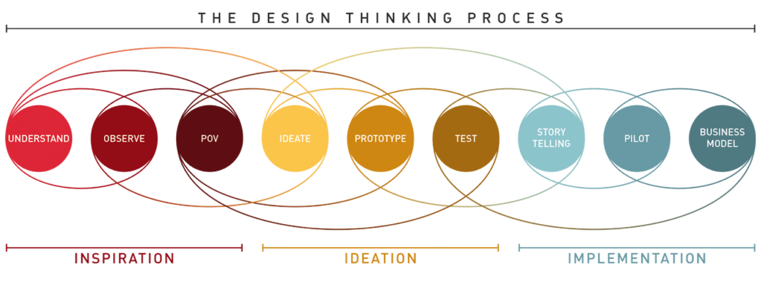

Slide 38
Diversify Select Amplify

Slide 39
Draw a boundary which allows you to focus and be effective. But remember the nature of interconnectivity, be grounded, adaptive, and listen to feedback and emergence, and always use an iterative process!
Manageable and scalable

Slide 40
7. BE AGNOSTIC ABOUT GROWTH : Growth Agnostic

Slide 41
No country has ever ended human deprivation without a growing economy...

Slide 42
We need an economy that needs to grow, whether or not it makes us thrive.

Slide 43
…no country has ever ended ecological degradation with one.

Slide 44
We need an economy that makes us thrive, whether or not it grows.

Slide 45
